Slide 1
Identifying the Lowest-Risk Aircraft for Investment
Moringa School Data Science Phase 1 Project
Anthony Muthee Njiru
Dated 29th April 2025

Slide 2
Overview
Project Goal: Determine lowest-risk aircraft models for corporate investment.
Audience: Head of Aviation Division (Business Stakeholders)

Slide 3
Business Understanding
Key Questions:
Which aircraft types have the lowest accident and fatality rates?
Which phases of flight pose the greatest risk?
How can we build a safe, diversified fleet?

Slide 4
Data Understanding
Dataset: NTSB Aviation Accident Records (1962–2023)
Fields: Date, Location, Phase, Make & Model, Accidents, Injuries, Fatalities

Slide 5
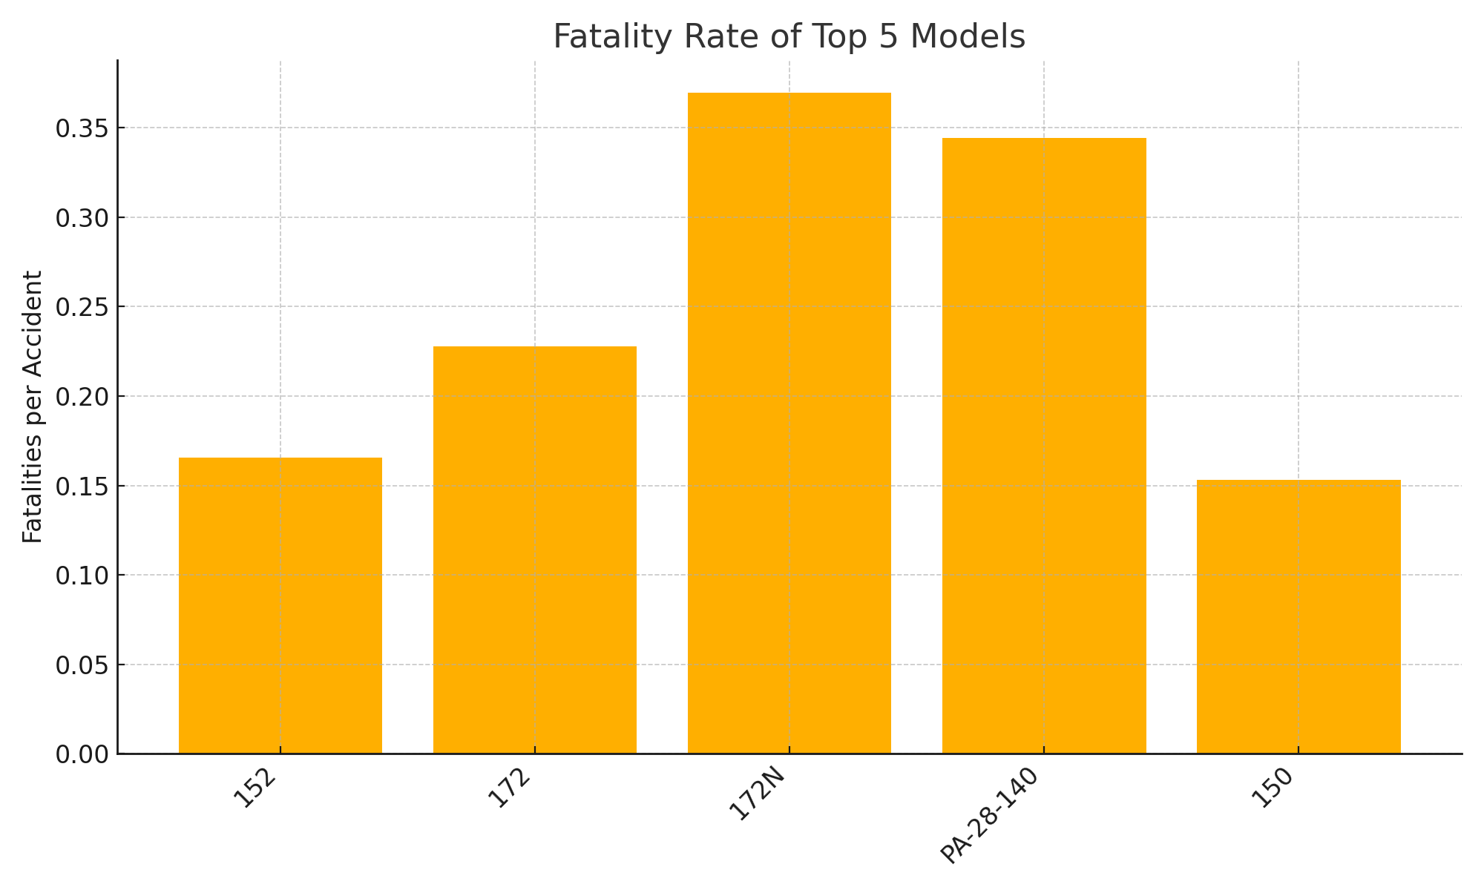
Fatality Rate of Top 5 Models
Model Code | Make
152 | Cessna
172 | Cessna
172N | Cessna
PA-28-140 | Piper
150 | Cessna
172M | Cessna
172P | Cessna
182 | Cessna
150M | Cessna
PA-28-180 | Piper
180 | Cessna
140 | Piper
152R | Cessna
210 | Cessna
PA-28-235 | Piper
150H | Cessna
PA-28-161 | Piper
152H | Cessna
140A | Piper
205 | Cessna

Slide 6
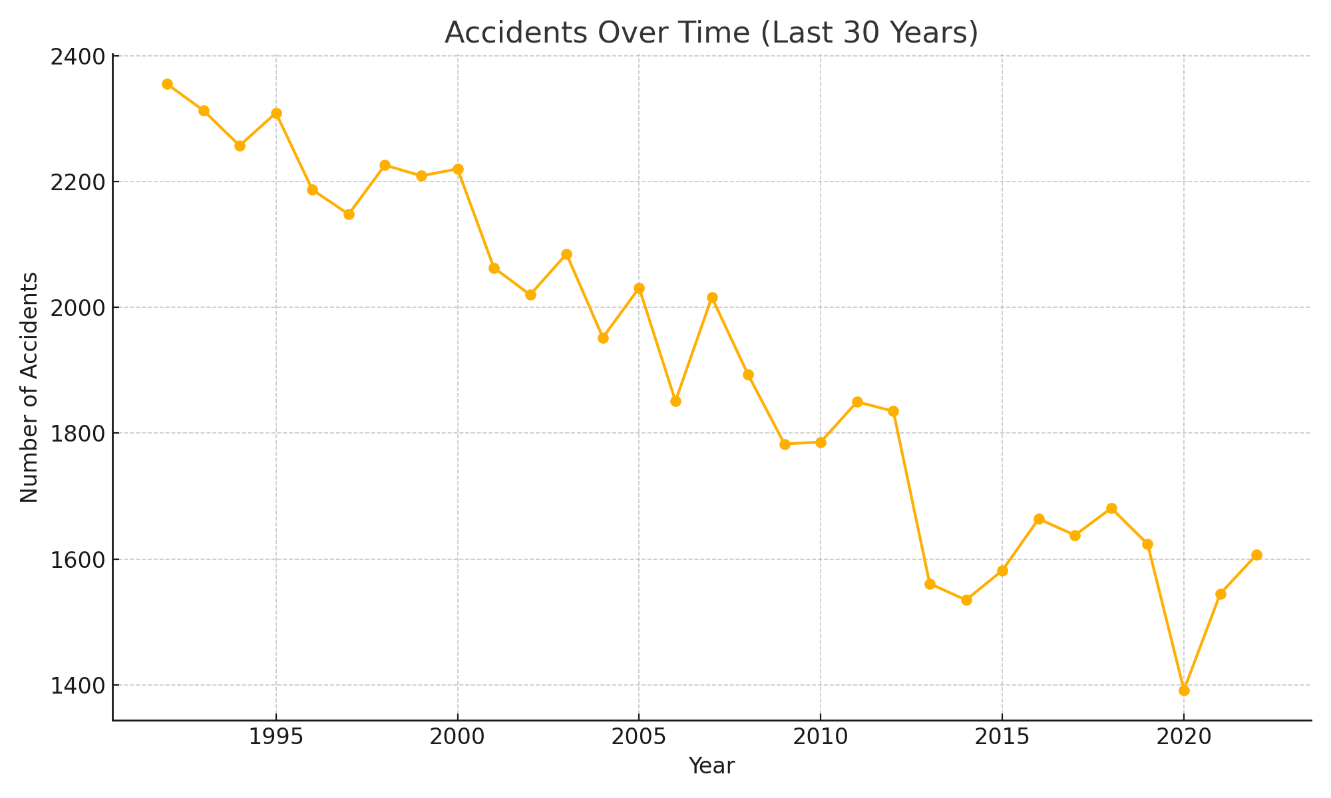
Accidents Over Time

Slide 7
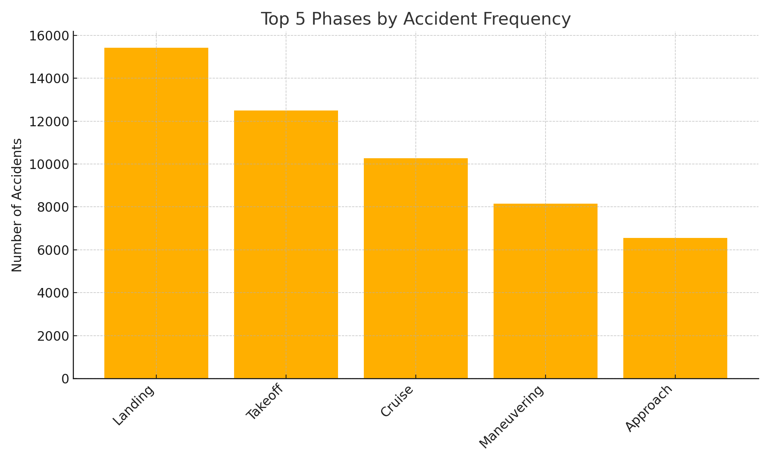
Phase-of-Flight Risk

Slide 8
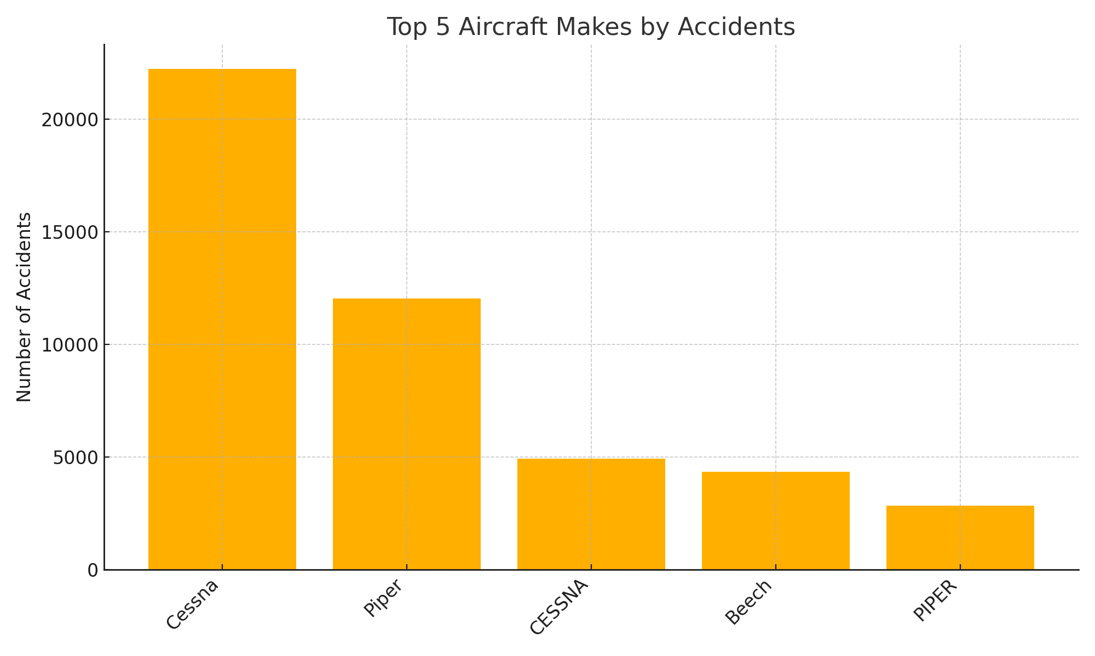
Accidents by Make

Slide 9
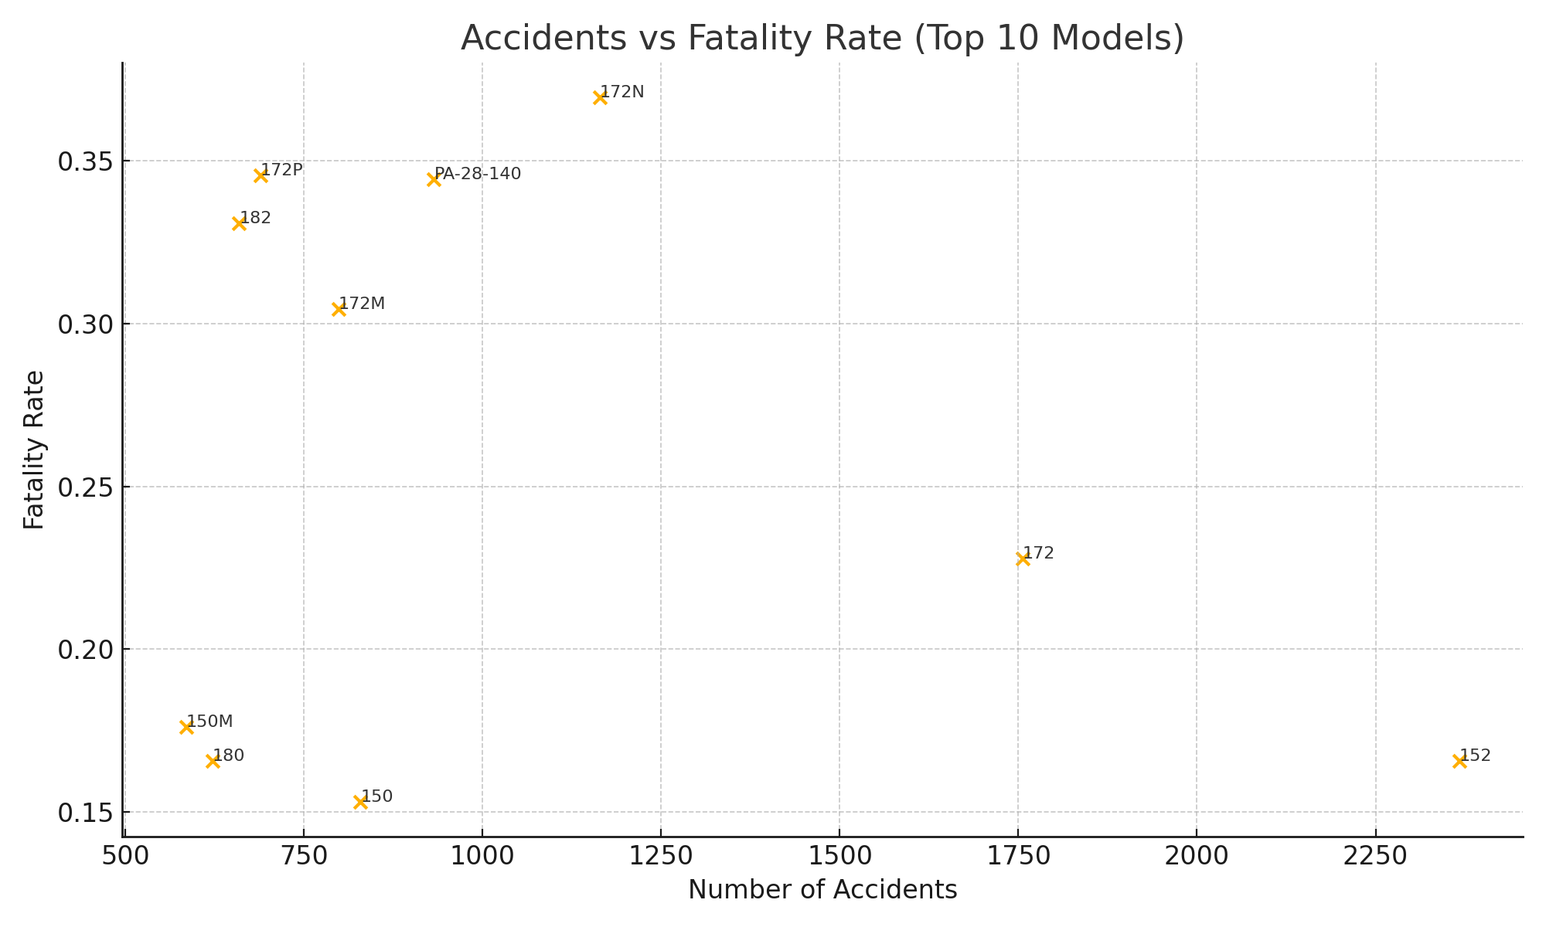
Accidents vs Fatality Rate
Model Code | Make
152 | Cessna
172 | Cessna
172N | Cessna
PA-28-140 | Piper
150 | Cessna
172M | Cessna
172P | Cessna
182 | Cessna
150M | Cessna
PA-28-180 | Piper
180 | Cessna
140 | Piper
152R | Cessna
210 | Cessna
PA-28-235 | Piper
150H | Cessna
PA-28-161 | Piper
152H | Cessna
140A | Piper
205 | Cessna

Slide 10
High accident numbers don’t mean “dangerous”—they reflect popularity and usage. What matters is how often those accidents turn fatal. The Cessna 172 shows many incidents but very few result in fatalities, making it our top-lowest-risk recommendation.
Inference From Data Analysis

Slide 11
Recommendations
1. Acquire Cessna 172 Skyhawk (Make: Cessna)
2. Acquire Piper PA-28 Cherokee Variants (Make: Piper)
3. Build a diversified fleet & implement safety protocols

Slide 12
Next Steps
• Develop pilot training curriculum focused on landing safety
• Establish maintenance schedules per manufacturer guidelines
• Deploy interactive dashboard for ongoing risk monitoring

Slide 13
Thank You
Contact: Anthony Muthee Njiru
LinkedIn: /anthony-njiru-3320a964/

